Slide 1
Mechanical Design

Slide 2
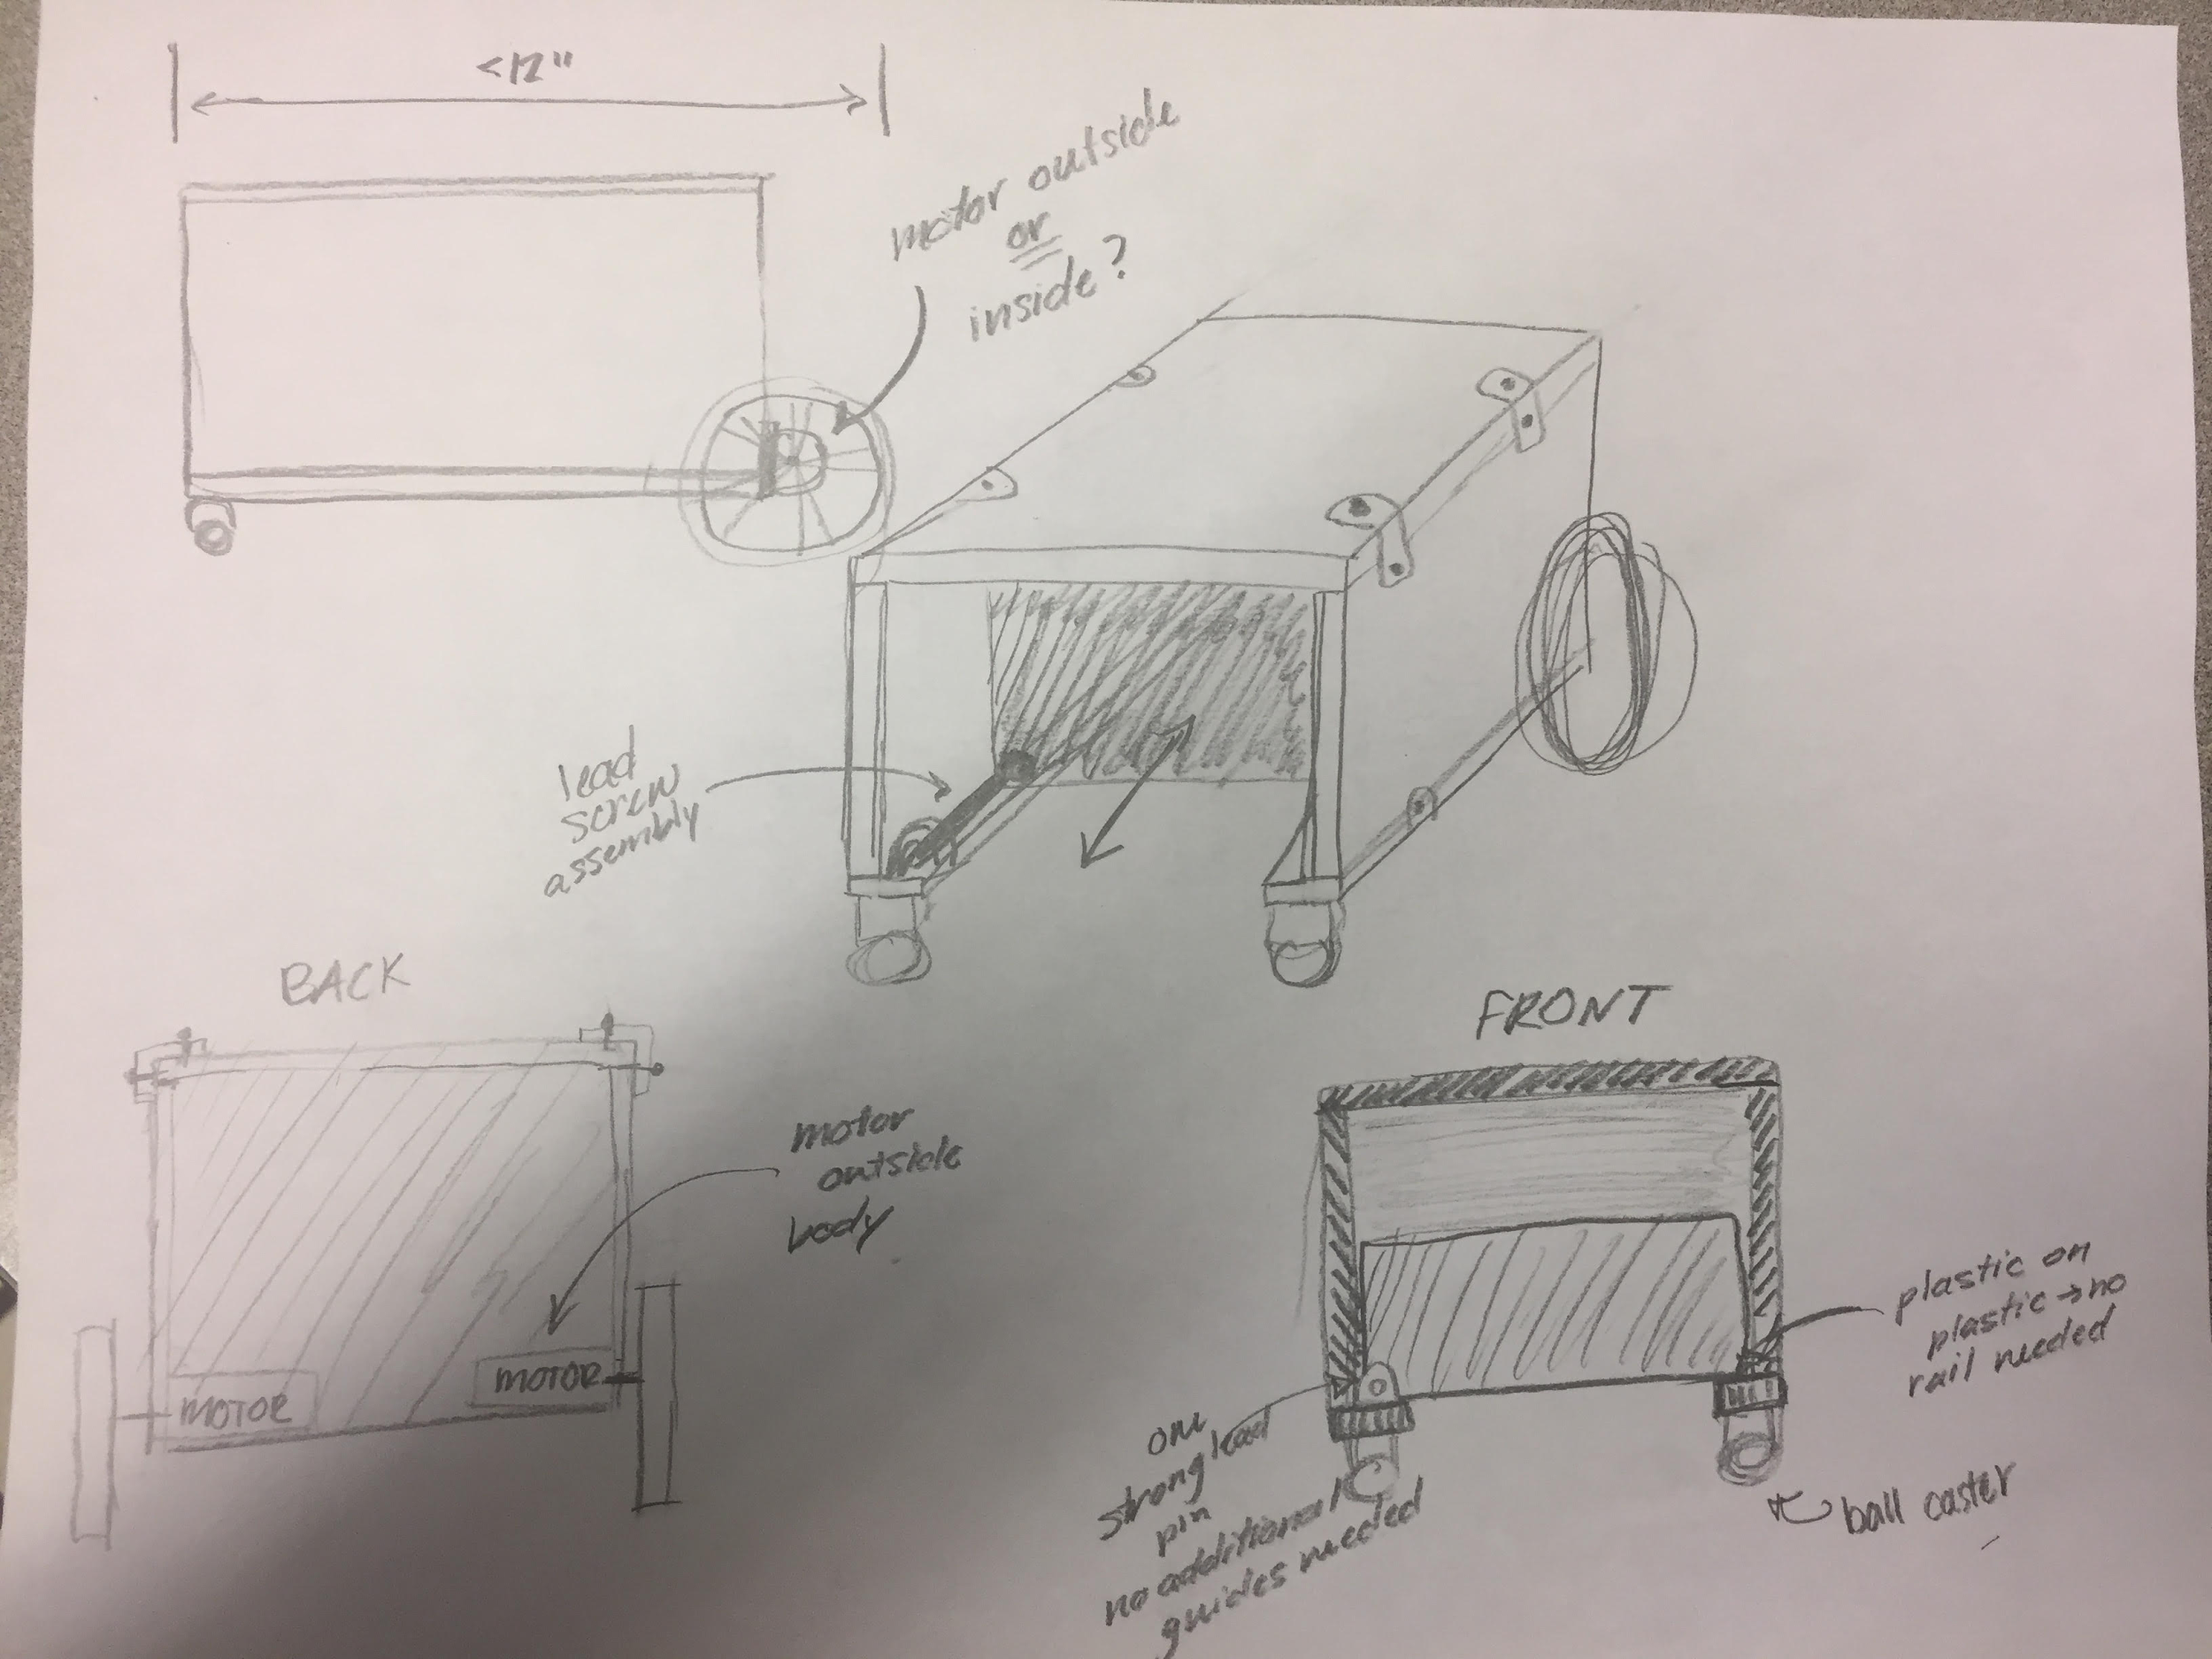
Chasis
Andria’s concept

Slide 3
BOM
ITEM | STATUS | LINK
Corner brackets | purchased | https://www.amazon.com/Tinksky-Stainless-Degree-Bracket-Fastener/dp/B01JOVO1N2/ref=sr_1_5?rps=1&ie=UTF8&qid=1488853278&sr=8-5&keywords=corner+bracket&refinements=p_85%3A2470955011
M3 fasteners | purchased | https://www.amazon.com/290pcs-Phillips-Washers-Assortment-Stainless/dp/B01K6NNYZ8/ref=sr_1_5?ie=UTF8&qid=1488853342&sr=8-5&keywords=m3+screw
Lead screw assembly | purchased | https://www.amazon.com/Witbot-Pillow-Bearing-Coupler-Printer/dp/B01MXYIWTD/ref=sr_1_12?ie=UTF8&qid=1488851037&sr=8-12&keywords=lead+screw+3d+printer
3/4" Plastic Ball Caster | purchased | http://www.robotshop.com/en/pololu-ball-caster-3-4-in-plastic-ball.html

